Slide 1

Course content
Morality and justice
Purposes of punishment
reformation
retribution
protection
deterrence
Responses to crime
custodial sentences
non-custodial sentences
capital punishment
Religious and non religious views on these issues

Slide 2

Learning Intentions: Today we are focusing on different punishments that are used in Scotland.
Success Criteria: By the end of the lesson you will be able to:
. Understand the main aspects of CPO’s, fines and tagging.

Slide 3
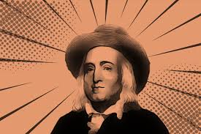
A non-religious response to this would be Utilitarian's. They would say the punishment must fit the crime and be fair. Perhaps spending so much money on prison is not fair on the rest of society or the criminal unless reform can be guaranteed. KU)
An implication of this is utilitarian's may support prison but the focus should be on reform. The consequences matter more than anything else. (AN)

Slide 4
23.2.23 Non-custodial

Slide 5


Over the last few years Scotland has begun a new and progressive way of dealing with crime.
In Scotland the focus has been on reforming offenders, and cutting short term prison sentences.
"Reducing the churn of short-term sentences will create more opportunity for prison staff to focus on interventions and support that will assist each individual to address their problems.”
Michael Matheson Justice secretary 2014-2018

Slide 6
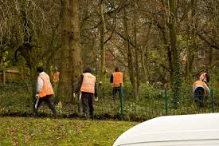

Non-Custodial
Some of the most commonly used alternatives to prison or non-custodial sentences are listed below:
Community Payback Order
Fines
Tagging / Curfew
Drug Treatment and Testing
Probation
Compensation

Slide 7
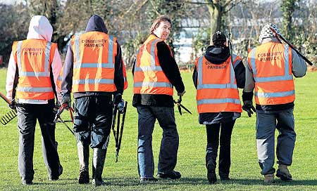
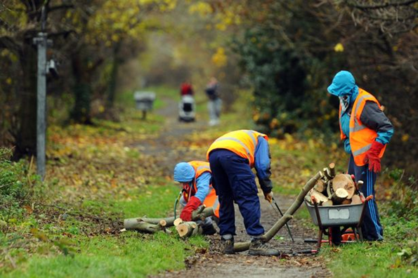
Community payback order.
(This used to be called community service)
The criminal is sentenced to do unpaid work in the community. To “pay back” the community as well as address the cause of their offending.

Slide 8
The criminal can be ordered to:
be supervised at certain times by a social or case worker
do unpaid work
have treatment for a drug or alcohol problem
stick to rules about how they behave
go to a programme of help
stay at an address of their choosing
have treatment for a mental health problem
pay money to a victim of your crime
There is no limit to the number of these that the court can impose.
Choose three of these and write them in your jotters.

Slide 9


Length of a CPO
A CPO can last between 6 months and 3 years.
During this time, the court may choose to set review dates. When they set a review date the criminal needs to go to court to give an update on their progress.

Slide 10

Since the introduction of CPO’s in 2011 by the then Justice secretary Michael Matheson there has been substantial evidence to show CPO’s work better at preventing reoffending then short term prison sentences.
As the Justice secretary until 2021 Humza Yousaf says:
The evidence shows that those released from a short prison sentences are reconvicted almost twice as often as those given CPOs, the value of community sentences is clear.

Slide 11

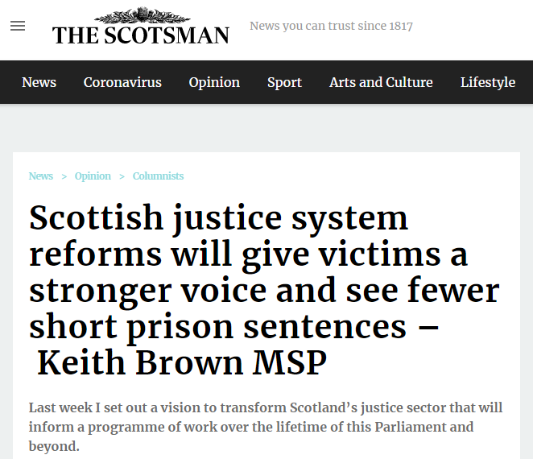
Look at a recent article where the new justice secretary, Keith Brown, shares his plans. Take notes on his main points.
https://www.scotsman.com/news/opinion/columnists/justice-system-reforms-will-see-fewer-short-prison-sentences-keith-brown-msp-3569004

Slide 12

Fines
Money paid as a punishment for a crime or other offence.
Fines are the most common penalty used by the Scottish criminal courts.
Find out how much someone in Scotland would be fined for:
1. Not having a TV license
2. Speeding

Slide 13

What do you think about fining someone for committing a crime?
Can you see any strengths or weaknesses of this approach?

Slide 14
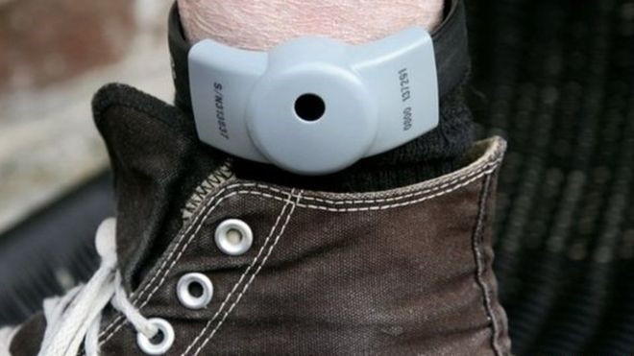
Electronic tagging
The offender has to wear an electronic device which tracks their movement to make sure that restrictions are observed.
Electronic monitoring was first piloted in Scotland in 1998, before being rolled-out nationally in 2002 .
It is now often used as a condition of release from prison.

Slide 15


Tagging is predominantly used to confine offenders to their homes overnight as an alternative to prison or under early release from jail - referred to as Home Detention Curfew.
Prisoners response is largely positive
http://www.bbc.co.uk/news/uk-scotland-scotland-politics-37544706

Slide 16

https://www.gov.scot/publications/electronic-monitoring-
uses-challenges-successes/pages/9/
Task:
Scottish government review of tagging
Read through this document.
Notice the sentences in bold and copy them into your jotter either directly or in your own words.
Consider: What does this teach us about tagging in Scotland?

Slide 17
https://www.bbc.co.uk/programmes/m000gxgv
How Scotland cut crime.

